Slide 1

Blockchain-Based Agri-Food Supply Chain
Under the guidance of
Ms Rosemary Mathews
MCA main project:
Aneena Anto
MCA-A Roll No 21

Slide 2
01
Relevance of the project
02
A Description of the Project
03
Contents
Objectives of design
CONTENTS
04
Existing System and Proposed System
05
System Design

Slide 3
01
Relevance of topic
Contents

Slide 4
Relevance of the project
These centralized systems lack transparency, accountability and auditability. In our proposed solution, we have presented a complete solution for blockchain-based Agriculture and Food (Agri-Food) supply chain. It leverages the key features of blockchain and smart contracts, deployed over ethereum blockchain network. Although blockchain provides immutability of data and records in the network, it still fails to solve some major problems in supply chain management like credibility of the involved entities, accountability of the trading process and traceability of the products..
Supply chains are evolving into automated and highly complex networks and are becoming an important source of potential benefits in the modern world. At the same time, consumers are now more interested in food productquality. However, it is challenging to track the provenance of data and maintain its traceability throughout the supply chain network. The traditional supply chains are centralized and they depend on a third party for trading

Slide 5
02
A Description of the Project
Contents

Slide 6

Description
The Supply Chain Management (SCM) is a group of processes and sub-processes carried out for transforming raw material into a final product, maximizing customer value and achieving a maintainable competitive advantage [1]. It is also interpreted as a network of entities that are part of the system from production to trading. The whole supply chain network is divided into several stages. Processes involved in these stages often take months to complete [2]. In such situation, if the final product lacks in quality, it becomes extremely difficult to track the root cause of the problem. The demand for top quality products and interest of end consumers in the provenance of data is increasing rapidly. Therefore, it has become necessary for every supply chain system to track the movement of products from origin to the end consumers

Slide 7
C o n t e n t s
03
Objectives of design

Slide 8
.Transparency .Traceability .Efficiency Efficiency . Traceability . Traceability

Slide 9
04
Existing System and Proposed System
Contents

Slide 10
Existing System
Underlying the agri-food systems is the essential data and information on the natural resources that support all forms of farming. As shown in Figure 1, data and information flow while products flow from inputs to output through various value-adding stages as well as financial flow from output to inputs. Different actors and stakeholders generate and manage data and information as per their needs and capacities. Smart agriculture is featured by the utilization of ICT, internet of things (IoT), and various modern data collection and analysis technologies including unmanned aerial vehicles (UAV), sensors and machine learning. A key issue of establishing smart agriculture is developing a comprehensive security system that facilitates the use and management of data. Traditional ways manage data in a centralized fashion and are prone to inaccurate data, data distortion and misuse as well as cyber-attack. For example, environmental monitoring data is generally managed by centralized government entities that have their own interest. They can manipulate the decision-making related to data.

Slide 11
Proposed System
The proposed system ensures trust among the trading entities and make sure that the buyer knows the reputation before purchasing the product from seller. Whenever the entities sign a smart contract for trading, the smart contract for reputation is also triggered that provides the reviews of available data sellers. Once the trading is successfully performed, the buyer also registers review for the seller on the basis of the products received. The review registered by the buyer is then stored against the seller’s profile in blockchain system. The smart contract as shown in Figure 3 utilizes four functions, i.e., RegisterReview(), SearchReview(), SaveReview, SendReview() and RequestReview(). These five functions are responsible for registering, checking content and ensuring the existence of a review, saving, sending and requesting for a new review, respectively. The RegisterReview() function takes metadata, ratings of the asset and review details as input. These values are then used by the end consumers to evaluate the quality of the product and reputation of the product owner.

Slide 12
05
System Design
Contents

Slide 13


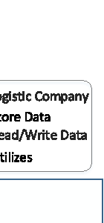

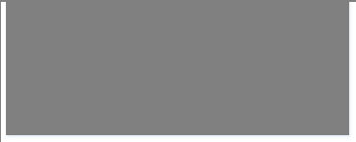

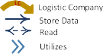







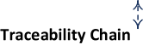


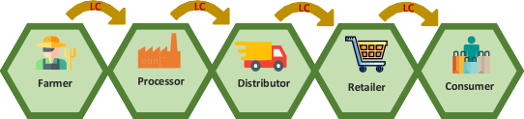

Slide 14
Farmer: A farmer is the first entity in Agri-Food supply chain and is the first one to invoke smart contract for trading. Farmer produces large amount of crops and take the responsibility for assuring and monitoring the crops’ growth details. He sells these crops to the processors. Processor: A processor buys the crops from farmers. He is responsible for eliminating extra material from the crops and converting them into a finalized product. Processor sells this finalized product to distributors. Distributor: A distributor maintains a warehouse by buying finalized products from processors and is responsible for selling it to the retailers
Retailer: A retailer buys the finished traceable products from distributors and sells them to customers in smaller quantities. Traceable product refers to specific identifiers of the goods that allow tracking the provenance data.
Consumer: Consumer is an end user who buys and consumes the products from retailers. A consumer verifies the credibility of a seller through reputation system before buying the products.
Logistic Company (LC) is responsible for an auditable delivery of the products from product owners to the purchasers.
Arbitrator is an off-chain entity that is selected to monitor and manage the entire network. Additionally, it also acts as dispute handler.

Slide 15
06
Modules
Contents

Slide 16
1.Traceability Module 2.Trading and Delivery Module 3.Reputation Module

Slide 17
THANK YOU

